Slide 1


Presentation title: NFC(Near Field Communication)
Course title: Wireless and Mobile Communication
Course code: ICT-4201
Presented by | Supervised by
Nusrat Jahan Bindu ID: IT-21003 Session: 2020-21 Dept of ICT, MBSTU | Dr. Nazrul Islam Associate Professor Dept. of ICT, MBSTU

Slide 2
TOPICS COVERED
What is NFC?
History of NFC
How does NFC work?
NFC mode of operation.
Application of NFC.
Advantages and limitations
NFC vs other technologies
Conclusion

Slide 3
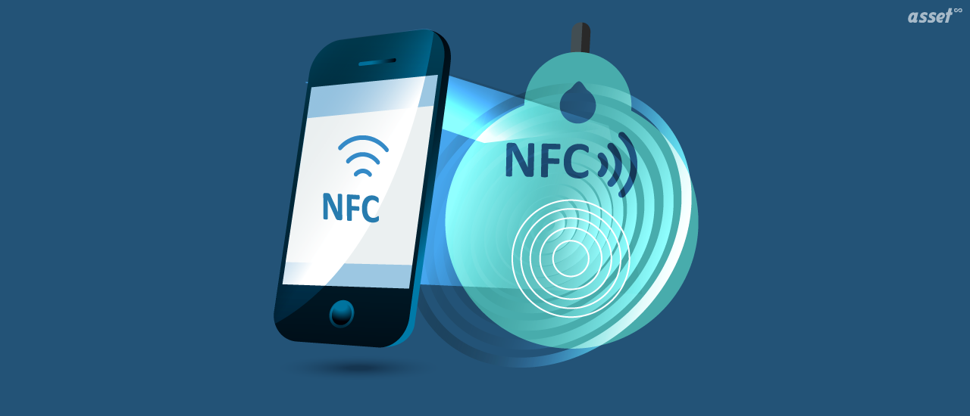
What is NFC?
NFC stands for ”Near Field Communication”
It is a short-range wireless technology that allows two compatible devices to exchange data when they are brought very close together, typically within a few centimetres.

Slide 4
History of NFC
Evolved from RFID technology in the early 2000s.
Developed by Sony and Philips in 2002.
NFC Forum established in 2004 for standardisation.
First NFC smartphone: Google Nexus S (2010).

Slide 5
HOW DOES NFC WORK?
Two devices come very close (within 4 cm).
The active device creates a magnetic field using a 13.56 MHz frequency.
The passive device gets power from this field (no battery needed).
Data is transferred by changing (modulating) the magnetic field.
The process is fast, secure, and automatic — no pairing required.

Slide 6
NFC mode of operation.
NFC has three main modes of operation.
Card Emulation mode
Peer-to-Peer mode, and
Reader/Writer.

Slide 7
Card emulation mode
In this mode, the smartphone or smartwatch can act as a contactless credit card, transit pass, or key.
It emulates a physical card to send payment or identity information to a reader.
An active device (the phone) communicates with a passive device (the reader).
Example : scanning an NFC smart poster or card

Slide 8
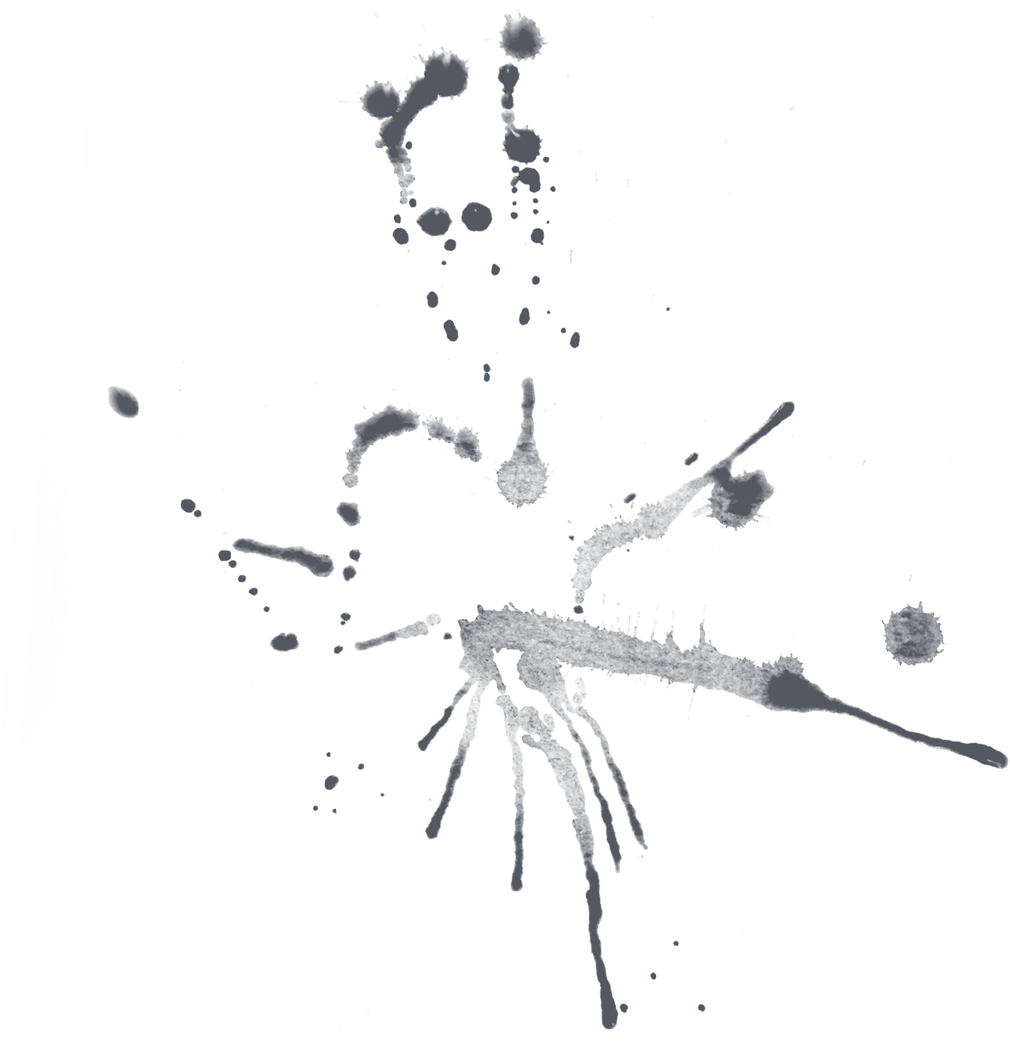

Peer-to-peer mode
This mode allows two active NFC devices to exchange data directly with each other.
Both devices have their own power source and can send and receive data.
Example: sharing contacts or files between smartphones.

Slide 9
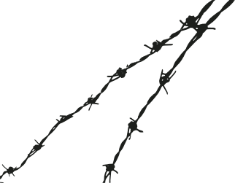

Reader/writer mode
An active device, such as a smartphone, acts as a reader to retrieve information from or write to a passive NFC tag.
The active device (reader) generates an electromagnetic field that powers the passive tag.
Example: using a phone for mobile payment like Google Pay or Apple Pay

Slide 10
Application of NFC.
Contactless mobile payments (Google Pay, Apple Pay).
Access control and door entry systems.
Public transportation ticketing.
Smart posters and marketing tags.
Transferring files or contact information.

Slide 11
Advantages of NFC
Limitations of NFC
Fast and easy connection setup.
Secure short-range communication.
No need for internet or pairing codes.
Low power consumption.
Very short range (~4 centimetres).
Limited data transfer speed.
Security threats if not properly encrypted.

Slide 12
NFC vs other technologies
Range: NFC works up to 4 cm — much shorter than Bluetooth or Wi-Fi.
Speed: Slower than Bluetooth and Wi-Fi.
Power: Very low power; can work without a battery (passive mode).
Connection: Instant connection — no pairing needed.
Security: More secure due to short range and encryption.
Use: Best for payments, access cards, and quick data sharing.

Slide 13
CONCLUSION
NFC is a fast, secure, and convenient short-range wireless technology that simplifies digital transactions and data sharing.
Despite its limited range and speed, its ease of use and strong security make it a leading choice for mobile payments and smart applications.

Slide 14
THANK YOU

